Slide 1
Governing Board Overview

Slide 2
Open Mainframe Project Overview and Governance

Slide 3





Vision
The mainframe is an active, integrated, and essential part of modern enterprise IT, consumable by mainstream developers and users, and driven by a vibrant open source community.
Mission
To achieve the vision of the Open Mainframe Project by…
The Open Mainframe Project was founded in 2015, as a focal point for deployment and use of Linux and Open Source in a mainframe computing environment.
Open Source is the collective thread within leading organizations that look to leverage their technology infrastructure as a competitive advantage. The mainframe design principles of security, stability, scalability, and performance are important to these leading organizations, and having the mainframe interoperable in a hybrid infrastructure enables leading organizations to realize its benefits. Open Mainframe Project believes this is best achieved as a community through open source.
Open Mainframe Project hosts 17 projects and working groups and is supported by 40 organizations.
Setting a high bar for application development on the mainframe
through documentation, API development, and a security-first approach.
Showcase the mainframe of today
to both the mainframe ecosystem as well as the broad enterprise IT community.
Enable the mainframe to be more consumable by developers
with a transparent experience in leveraging the value propositions of the mainframe.
Ensure the mainframe aligns well in the changing enterprise IT landscape
of cloud-native and DevOps.
Notes:
The mission of the Open Mainframe Project is to build that community and adoption of Open Source on the mainframe, which will ( read points above )
Image from https://www.openmainframeproject.org/about

Slide 4

Member Organizations
Learn more about membership at openmainframeproject.org/join
Notes:
Source: https://landscape.openmainframeproject.org/embed/embed.html?base-path=&classify=category&key=open-mainframe-project-member-company&headers=false&category-header=true&category-in-subcategory=false&title-uppercase=false&title-alignment=center&title-font-family=sans-serif&title-font-size=13&style=clean&bg-color=%230033a1&fg-color=%23ffffff&item-modal=false&item-name=false&size=md&items-alignment=center

Slide 5
We’re a nonprofit, but not separately incorporated
The Open Mainframe Project is part of the the Linux Foundation and is not a separate legal entity
Therefore, the Open Mainframe Project Governing Board is not a corporate board of directors, and is not subject to corporate law statutes (e.g., those that govern fiduciary duties and how corporate boards of directors must operate)
The powers and duties of the Governing Board are set forth in the Open Mainframe Project Charter

Slide 6
Open Mainframe Project Governance at a glance
Cross-project collaboration
Project Lifecycle Management
Developer Voice to GB
Technical Advisory Council (TAC)
Open Mainframe Project
Governing Board
Strategy & Priorities
Budget
Marketing Strategy & Events
Legal & overall governance
Marketing Committee
Zowe
ADE
Mentorship
Zorow
etc
Annual Marketing Plan
PR
Events
Content/Web
Branding
Market Development
Developer Communities
The Linux Foundation Internal Use Only

Slide 7
Key Governing Bodies and Committees
Business & Marketing Leadership
Governing Board (Governing Board)
Budget Committee
Legal Committee
Marketing Committee
Technical Leadership
Technical Advisory Council (TAC)
You can review the TAC meeting information and upcoming schedule and join the mailing list
Hosted Projects and Working Groups

Slide 8
Governing Board
Responsibilities

Slide 9
Governing Board Responsibilities
The Governing Board’s responsibilities include:
Approving the Open Mainframe Project budget, directing the use of funds to advance the mission of the Open Mainframe Project;
Providing financial governance overall;
Voting on other decisions that come before the Governing Board.
Additional responsibilities are described in Section 3 of the Open Mainframe Project Charter.

Slide 10
What the Governing Board is NOT responsible for
The Governing Board does not make technical decisions for Open Mainframe Project other than working with the TAC to set the overall scope for the Open Mainframe Project.
The Governing Board is not responsible for overseeing day-to-day operations of Open Mainframe Project. This is the responsibility of the foundation staff.
The Governing Board is not a Board of Directors; it is a committee that provides budget oversight and direction. There are no personal liabilities for individual Governing Board representatives.

Slide 11
Governing Board Operations

Slide 12
Governing Board Composition
The Governing Board voting members consist of:
One representative appointed from each Platinum Member; and
One representative appointed from each Platinum End-User Member;
One Silver Member representative for every 10 Silver Members; with no more than three Silver Member representatives;
One Academic Institution Member representative for every 10 Academic Institution Members; with no more than three Academic Institution Member representatives;
The TAC Chair.
See Section 3(a) of the Open Mainframe Project Charter for more information about composition.

Slide 13
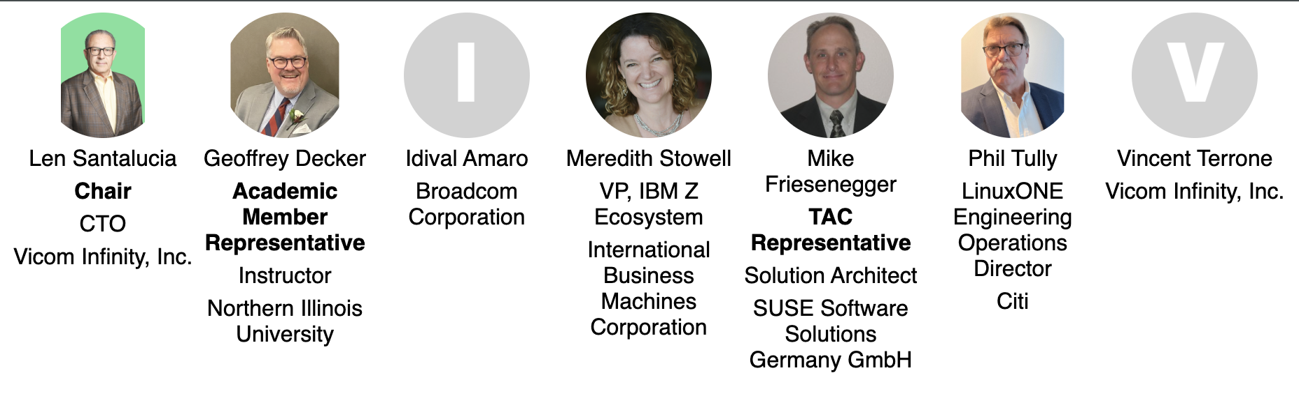
Governing Board Representatives
Notes:
https://jmertic.github.io/committee-gallery/open-mainframe-project-governing-board.html

Slide 14
Governing Board Chairperson
Duties of the Governing Board Chairperson include:
Oversee the day-to-day operational decisions of the Open Mainframe Project.
Work with the project staff to prepare the agenda for Governing Board meetings.
Be a spokesperson for the Open Mainframe Project and the Governing Board, as needed
See Section 3(c) of the Open Mainframe Project Charter for more information about the chairperson role.

Slide 15
Governing Board Meetings

Slide 16
Meeting Cadence
The Governing Board has virtual regular meetings, generally once a quarter, on the 2nd Wednesday of the 2nd month of the quarter.
The Governing Board meets in person for an annual strategic planning session in late Q3/Q4, typically around an event. More details on this will be shared towards the beginning of Q3.
In rare and exceptional circumstances (e.g., in an emergency situation), an additional ad hoc special meeting of the Governing Board may be convened.
To request a special meeting, please email your request to the Project Staff and Governing Board Chair, and they will decide whether a special meeting is necessary or the proposed agenda item can be discussed by email or at the next regular meeting.

Slide 17
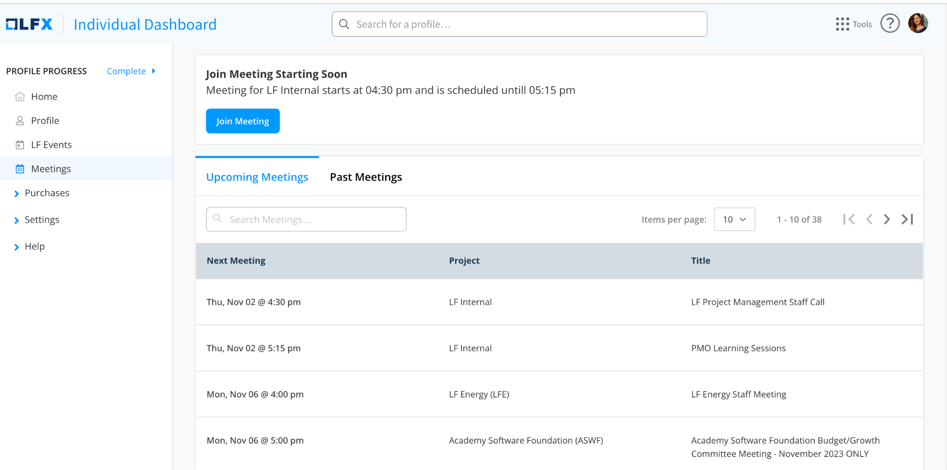
2026 Governing Board meeting schedule
All meetings from 2:00pm - 3:30pm US Eastern time unless noted.
February 11, 2026
May 13, 2026
August 12, 2026
November 11, 2026
Meeting will be on your calendar, and available at openprofile.dev/my-calendar

Slide 18
How to Propose an Agenda Item
If you would like to propose an agenda item for discussion at a Governing Board meeting, please submit your proposal to the Open Mainframe Project Director & the Governing Board Chair.
Please include in your request:
A description of the topic
Board resolution or discussion-only item
Requested amount of time to discuss the item
Please submit your proposed agenda item at least 30 days prior to the meeting.

Slide 19
Proposing an agenda item (continued)
Please be patient. Our board meeting agendas are often very full. If we cannot accommodate your request in the upcoming meeting we may:
Wait until the following meeting to discuss the topic
Call a special meeting to discuss your topic, or
Refer the topic to the appropriate committee or task force of the Governing Board.
We may ask you to provide slides 5 days before the meeting, and slides are subject to change (with your approval) to fit the broader meeting slide deck.

Slide 20
Governing Board Materials
Agendas and exhibits for Governing Board meetings will be made available one week prior to the scheduled meeting
The FINAL deck will be made available one day prior to the meeting.
Past meeting materials can be found here.
All meeting materials are confidential and for the view of Governing Board representatives and their alternates ONLY, unless otherwise specified.
No meeting of the Governing Board is recorded unless the Governing Board provides explicit consent to do so.

Slide 21
Discussion Channels
Relevant Mailing Lists
Governing Board: omp-board@lists.openmainframeproject.org
TAC: omp-technical@lists.openmainframeproject.org
Budget Committee: omp-budget@lists.openmainframeproject.org
Slack Channel
You can join Open Mainframe Project slack here.
To join the Governing Board slack channel, make a request at members.openmainframeproject.org.

Slide 22
Governing Board Committees

Slide 23
Budget Committee
The Budget Committee is lead by the Governing Board Treasurer and collaborates with the Open Mainframe Project staff to develop and review the Open Mainframe Project budget.
Any Governing Board representative may join ( not alternates )
Meets generally quarterly on the Wednesday of the week before the Governing Board meeting
ACTION: If you want to participate in the Budget Committee, make a request at members.openmainframeproject.org.

Slide 24
Legal Committee
The Legal Committee makes recommendations to the Governing Board regarding license exception requests from Open Mainframe Project projects and other questions submitted to the Legal Committee by the Governing Board.
The Legal Committee does not represent Open Mainframe Project and does not have an attorney-client relationship with Open Mainframe Project.
Meets on an as needed basis.
Governing Boards may attend only if accompanied by their legal counsel.

Slide 25
Policies and Other Resources

Slide 26
Important Open Mainframe Project Policies and Resources
Open Mainframe Project Charter
Linux Foundation Antitrust Policy
Project GitHub repository with many other public facing policies and materials including…
Elections Process
Open Mainframe Project hosted project charters, which define each project’s intellectual property and licensing policies.
OMP Landscape
High Level Overview

Slide 27
LFX Organization Dashboard
LFX Organization Dashboard provides access to key membership materials, including…
Member contacts, which you can change at any time ( look under ‘Users’ > and then under the ‘Key People’ tab )
Membership details ( look under ‘Membership’ > ‘Open Mainframe Project’ ), including…
Membership Overview Deck and High Level Overview Deck ( look under the ‘Resources’ tab )
Your fully executed membership agreement ( look under the ‘Membership’ tab )
Details on how to leverage membership benefits ( look under the ‘Benefits’ tab )
Insights on contributors from your organization ( look under the ‘Project Contributors’ tab )
ACTION: Request access to LFX Organizational Dashboard here.

Slide 28

Open Mainframe Project staff
Contact us at members.openmainframeproject.org

Slide 29
Who’s Who in the Academy Software Foundation
Open Mainframe Project Members
Staff: Open Mainframe Project Staff, Linux Foundation Leadership
Governing Board Members
Technical Advisory Council Members
Open Mainframe Project Project and Working Group Leads

Slide 30
Thank you!
If you have any questions, feel free to contact the staff at: members.openmainframeproject.org.

